Slide 1

Serendipity-Aware Career Recommendation System
Atharva Patil(22106039)
Shraavani Salunkhe (22106031)
Brahmjot Singh (22106004)
Aniruddha Pawar (22106009)
Project Guide
Ms. Tejashree Kolhe

Slide 2
Outline
Introduction
Literature Survey of the Existing Systems
Limitations of the Existing Systems
Problem Statement
Proposed System Design
Framework/Algorithm
Technologies Stack for Proposed System
Implementation
Conclusion
Reference

Slide 3
Introduction
Career confusion-Many students struggle to choose a career path that aligns with their skills and interests.
Technology driven solution-Our system uses machine learning to provide customized career recommendations.
Serendipity factor- Introduces unexpected yet relevant career options to broaden students' career exploration.

Slide 4
Motivation:-
Difficulty in identifying the right career path due to lack of personalized guidance.
Traditional career counseling methods do not adapt to evolving job market trends.
Objective:-
Develop an AI-powered system using Random Forest for career recommendations.
Integrate serendipity to suggest unexpected yet relevant career options.

Slide 5
Literature Survey of the existing system
Sr. No. | Author and year | Method | Advantages | Disadvantages
1. | Serendipity-Oriented Recommendations for Improving User Satisfaction 2023 | RNN, BOW, Course2Vec | Improves recommendation relevance, considers enrollment history | Lacks novelty, RNN recommendations are repetitive
2. | Student Career Recommendation System Using Content-Based Filtering Method 2022 | Content-Based Filtering | User-friendly interface, effective job matching | Limited to Computer Science careers, depends on available job data

Slide 6
Sr. No. | Author and year | Method | Advantages | Disadvantages
3. | Design and implementation of career planning system based on machine learning 2023 | Collaborative Filtering, Cluster Analysis | Solves cold start problem, achieves high accuracy (97.80%) | Requires large datasets, potential overfitting
4. | Framework Design of Intelligent Career Recommendation System for Undergraduates 2022 | RippleNet, Knowledge Graph | Provides secure and structured career recommendation | Implementation complexity, requires continuous data updates
5. | Job and Course Recommendation System using Collaborative Filtering and Naive Bayes algorithms 2023 | Naïve Bayes, Collaborative Filtering | Personalized suggestions, combines multiple approaches | Needs additional data sources for better accuracy

Slide 7
Limitations of existing systems
Cold Start Problem – New users may receive less accurate recommendations due to a lack of prior data.
Limited Career Scope – The system may not cover all career domains beyond predefined categories.
Data Dependency – Accuracy relies on the quality and availability of user input and job market trends.
Bias in Recommendations – The model may favor certain careers based on training data, limiting diversity.
Absence of AI/ML-Based Insights-Most platforms do not utilize machine learning models to analyze patterns and improve recommendations.

Slide 8
Problem statement
Career Confusion – Difficulty in choosing the right career path.
Lack of Personalization – Generic career suggestions with no
customization.
Limited Exploration – Missed unconventional but relevant
career options.

Slide 9
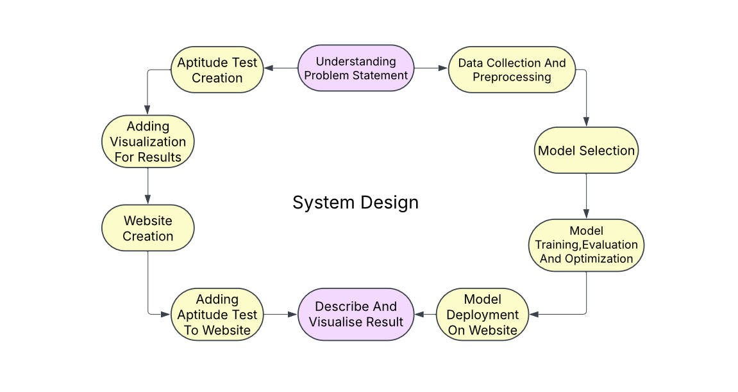
Proposed System Design

Slide 10
Framework/Algorithm
The project is built as a career recommendation system using Machine Learning (ML) and Natural Language Processing (NLP) techniques. The key algorithms used are:
1. Random Forest Classifier:-
Used in mlmodel.py and mlmodelbackup.py for career prediction based on user input.
The model is trained using labeled career preference data (stud.csv).
2. TF-IDF (Term Frequency - Inverse Document Frequency) Cosine Similarity:-
Implemented in app.py to suggest alternative careers based on textual similarity.
Cosine similarity identifies careers closely related to the predicted one.
3. Holland Personality Test (RIASEC Model):-
Implemented in aptitude_test.py.
Determines user personality type and suggests careers accordingly.
Uses categorical mapping of personality types (R, I, A, S, E, C) to career options.

Slide 11
Tools used
1.Python – For backend development and machine learning
implementation.
Streamlit – For building the user interface.
Scikit-learn – For implementing the Random Forest algorithm.
Pandas & NumPy – For data processing and analysis.
Joblib – For model saving and loading.
Matplotlib – For data visualization.
SQLite + Hashlib-Authentication and Security:

Slide 12
Implementation

Slide 13
Conclusion
Personalized Guidance – Career suggestions based on interests and skills.
Serendipity Factor – Introduces unexpected yet relevant careers.
ML-Based Accuracy – Uses Random Forest for reliable predictions.
User-Friendly UI – Simplifies decision-making.

Slide 14
References
Serendipity-Oriented Recommendations for Improving User SatisfactionWANG, N. (Author). 29 Jun 2023
A. H. A. Rashid, M. Mohamad, S. Masrom and A. Selamat, "Student Career Recommendation System Using Content-Based Filtering Method," 2022 3rd International Conference on Artificial Intelligence and Data Sciences (AiDAS), IPOH, Malaysia, 2022, pp. 60-65
C. Sun, "Design and implementation of career planning system based on machine learning," 2024 IEEE 3rd International Conference on Electrical Engineering, Big Data and Algorithms (EEBDA), Changchun, China, 2024, pp. 68-73
W. Liu, L. Niu and J. Zhao, "Framework Design of Intelligent Career Recommendation System for Undergraduates," 2022 International Conference on Intelligent Education and Intelligent Research (IEIR), Wuhan, China, 2022, pp. 256-261
D. P. B, M. K, V. K and Y. D, "Job and Course Recommendation System using Collaborative Filtering and Naive Bayes algorithms," 2023 2nd International Conference on Advancements in Electrical, Electronics, Communication, Computing and Automation (ICAECA), Coimbatore, India, 2023, pp. 1-4

Slide 15
Thank You

